Slide 1







BUILD
WITH
भारत 2.0
N A T I O N A L L E V E L H A C K A T H O N
TEAM NAME: C o d e W a r r i a r 2.O
T E A M L E A D E R : R a m a n K u m a r T i w a r i
PROBLEM STATEMENT : G r e e n E n e r g y M a n a g e m e n t
TEAM MEMBERS : S a t y a m K u s h w a h a , A y u s h K u m a r , A m i t K u m a r M a n d a l , A r p i t T i w a r i
COLLEGE : R o o r k e e I n s t i t u t e o f T e c h n o l o g y , R o o r k e e , U t t r a k h n d
भा र त 2 . 0

Slide 2

PROBLEM STATEMENT
“India produces green energy, but we still lack affordable, user-level intelligence to use it optimally.”
Fragmented Visibility— No real-time tracking of energy consumption or solar vs source for households,
societies & MSMEs
Wasted Green Energy —only small power (GW) rooftop solar potential installed - users can't monitor what they generate
High Energy Wastage — Buildings waste 15–25% of electricity due to unmonitored, unoptimized usage
No Carbon Accountability — Grid emits 0.61 - 0.71 kg₂/kWh, yet consumers have no affordable tool to measure their footprint, even as CCTS 2023 makes reporting mandatory
Disconnected from Smart Grid — No Time-of-Use tariffs, no net-metering tracking, no demand-response → DISCOMs lose ₹60,000+ Cr/year
Existing Solutions Are Fragmented— Enterprise EMS costs lakhs (Schneider/Siemens), solar apps are hardware-locked (SolarEdge), bill trackers are shallow → no affordable, unified platform exists
भा र त 2 . 0

Slide 3
SOLUTION
“An AI-based energy management platform. Keep your existing solar setup. Add intelligent monitoring, smart scheduling & transparent savings - a retrofit, not a replacement“
Retrofit-first — works with existing solar panels, inverters & wiring; no replacement cost
Two connection routes:
Route A: Inverter data via owner-approved API / Modbus (e.g., Fronius Solar API)
Route B: External AC energy meter + CT sensors (ESP32-based) where data is closed/missing
first scheduling — not just ON/OFF toggle: "Run 30-min pump before 4 PM in solar-surplus slot" with deadlines, runtime limits & critical-load protection
Savings Receipt — every action shows measured kWh × baseline comparison = extra ₹ saved (transparent, not exaggerated)
Carbon estimate — imported kWh × CEA grid emission factor, with factor year & assumptions visible
Safety-first — no meter-seal tampering, qualified electrician installation, no DIY mains switching
भा र त 2 . 0

Slide 4
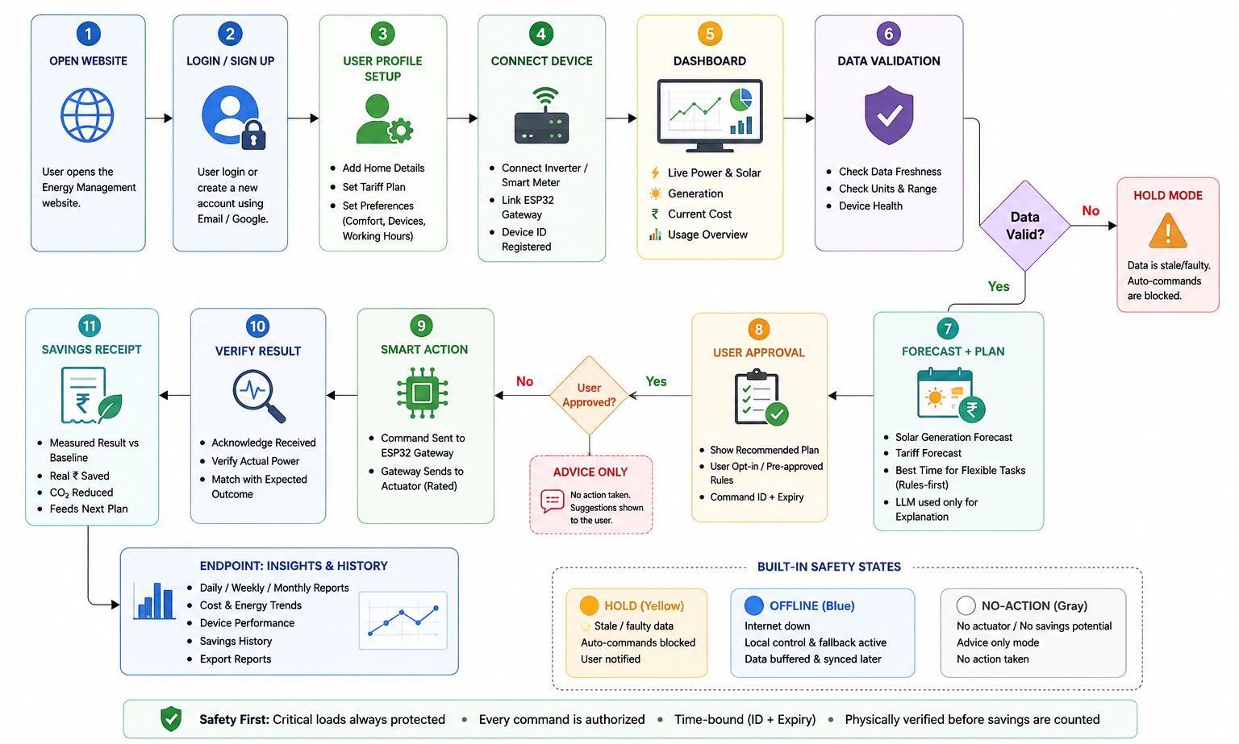
FLOW OF SOLUTION
भा र त 2 . 0

Slide 5
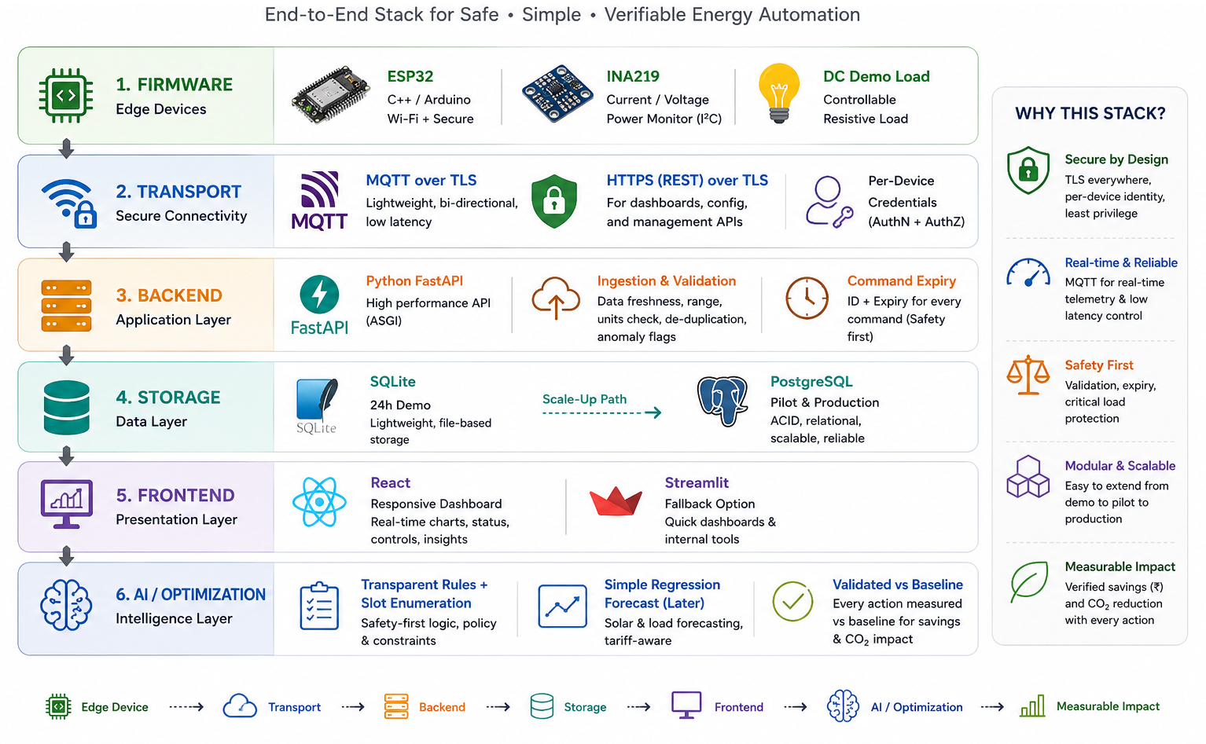
TECH STACK
भा र त 2 . 0

Slide 6
UNIQUE SELLING PROPOSITION (USP)
RETROFIT → TASK → PROOF
RETROFIT
Keep the existing solar setup — inverter, meter and electrical infrastructure.
Connect through supported APIs / Modbus / external metering only where required.
Eligibility-first approach: if existing equipment already provides the benefit, no unnecessary hardware.
Designed for practical, affordable deployment rather than replacing the complete setup.
TASK
Convert energy insights into useful actions, not just dashboards.
Schedule flexible loads such as pumps, EV charging or other eligible tasks.
Consider solar availability + tariff + deadline + runtime + user preference.
Critical loads remain protected and every automated action requires authorization.
PROOF
Measure → Compare → Verify → Report.
Compare the optimized task against a defined, comparable baseline.
Generate a Savings Receipt showing measured energy, estimated ₹ benefit and CO₂ impact.
Only verified outcomes become inputs for the next optimization cycle.
Safe • User-approved • Rules-first • Measured • Transparent
भा र त 2 . 0

Slide 7
FEASIBILITY & COMPETITORS
FEASIBILITY
Prototype — HIGH: ESP32, safe DC sensor/load, MQTT/HTTPS, FastAPI, SQLite/PostgreSQL, React dashboard, rule-based scheduler, simulated solar/tariff data
Pilot — MEDIUM/HIGH: Needs compatible inverter/meter, qualified electrician, certified metering, rated actuator, real tariff data, security review
Universal Commercial Deployment — NOT YET PROVEN: Multi-manufacturer compatibility, long-term reliability, real-home trials, utility integration, large-scale validation
COMPETITORS
SolarEdge ONE — AI-powered energy optimization within the SolarEdge ecosystem.
Schneider Wiser — Smart-home energy monitoring, control & predictive scheduling for supported devices.
Shelly — Energy metering + connectivity + device control through supported hardware.
Inverter Apps — Primarily provide solar generation, consumption & system monitoring.
Smart Energy Meters — Provide real-time energy measurement and visibility.
Manual Scheduling — Relies on user decisions without automated optimization or verified savings.
UrjaSetu
Retrofit existing infrastructure → Schedule useful tasks → Safely execute → Verify → Generate a Savings Receipt.
“Existing solutions monitor, measure or optimize; UrjaSetu connects these capabilities into a user-approved, task-focused and proof-based workflow.”
भा र त 2 . 0

Slide 8
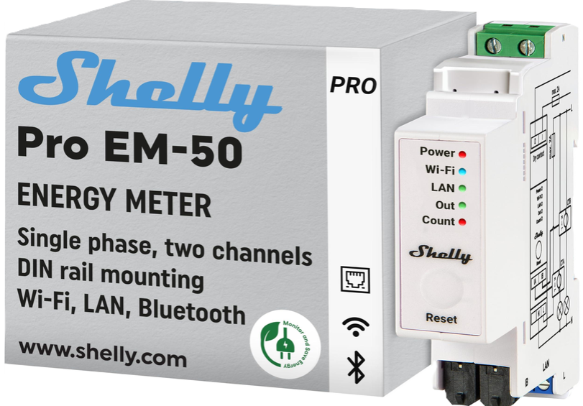
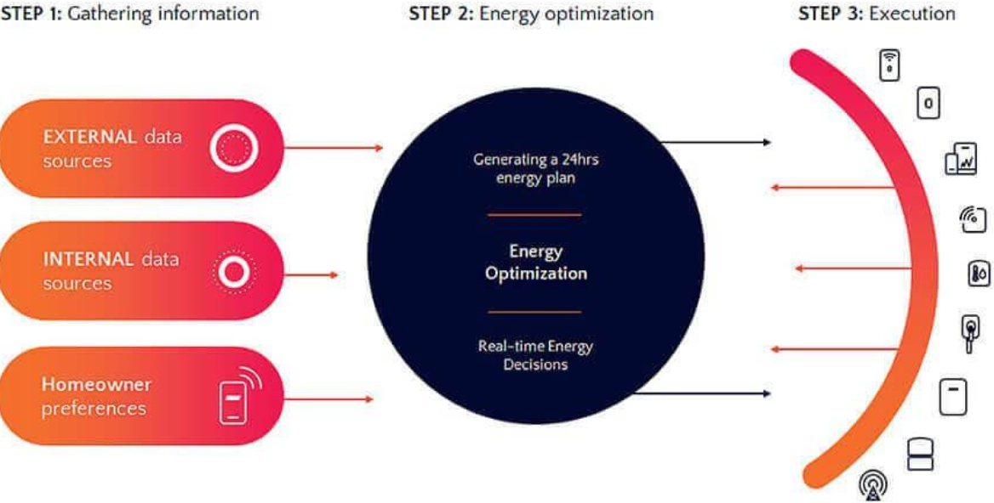
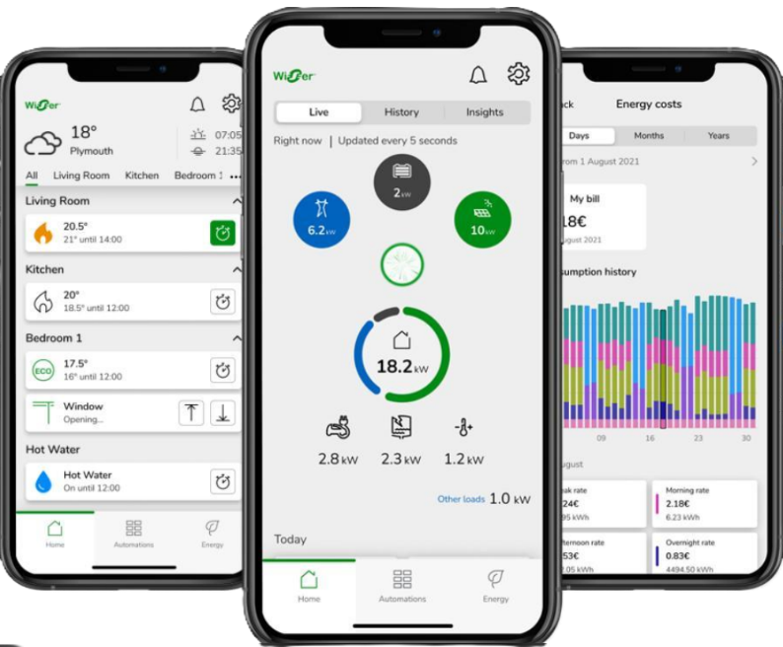
RESEARCH & REFERENCE
SolarEdge ONE — AI-based energy optimization and personalized energy planning.→ solaredge.com
Schneider Wiser — Home energy monitoring, control and AI-powered optimization for supported devices.→ se.com press release
Fronius Solar API — Official REST/JSON inverter-data access → fronius.com
Shelly Pro EM-50 — Energy metering + connectivity + contactor-control capability.→ shelly.com
Espressif ESP-MQTT — MQTT 5, TLS, auth, QoS, mutual TLS on ESP32 → docs.espressif.com
CEA CO₂ Baseline Database v21.0 — Grid emission factor source → cea.nic.in
Github Repo Link :
Prototype Link :
भा र त 2 . 0

